Slide 1
Permaforest Trust Individual Project
A biomass-biochar stove
By James Jenkinson

Slide 2
Introduction
VISION STATEMENT
To design an affordable, clean-burning, durable, safe and sustainable 'carbon negative' stove technology for the over-developed and under-developed worlds.
WHY?
Increasing need for improving the affordability, efficiency, durability, safety and sustainability of cookstoves
Interrelated environmental stresses connected to the design and usage requirements of stoves that affect human and environmental health and sustainability.
Stresses include climate change, biodiversity conservation, human respiratory health and e-waste - just to name a handful.
Purpose of study is to design a cutting edge stove that addresses these stresses

Slide 3
Main stakeholders
Mullubimby Community Garden (biochar pod, kitchen pod)
Project 540
Stovers/The stoving community
Neighbours
Misc permies
Byron Shire Council
Green movement
Entrepeneurs
Farmers
Researchers eg. CSIRO Wollongbar
Politicians
Forestry workers
Woodburn mill (biomass pelletisation)

Slide 4
Research overview
Biochar overview
Biomass production
Biomass harvesting
Biomass pelletisation
Local interviews
Community and bioregional
Glocal (Global/Local)
Stove design and building

Slide 5
Biochar overview
Biochar is "the carbon-rich product obtained when biomass, such as wood, manure or leaves, is heated in a closed container with little or no available air" (Lehmann, J. & Joseph, S. (Eds.), 'Biochar for Environmental Management: Science and Technology', U.K., Earthscan, 2009, p.1).
Biochar is a 2,000 year-old practice that converts agricultural waste into a soil enhancer that can hold carbon, boost food security and discourage deforestation. The process creates a fine-grained, highly porous charcoal that helps soils retain nutrients and water (International Biochar Initiative)
Main reason for biochar technology (Lehmann & Joseph,p.5), is to mitigate climate change, produce energy, improve soil and manage waste.

Slide 6
Biomass overview 1
Biomass is organic matter, which includes forest and mill residues, agricultural crops and wastes, wood and wood wastes, animal wastes, livestock operation residues, aquatic plants, and municipal and industrial wastes.
The biomass industry is receiving increasing attention from the public as scientists, policy makers, and growers search for clean, renewable energy alternatives.
Compared with other renewable resources, biomass is very flexible; it can be used as a fuel for direct combustion, gasified, used in combined heat and power technologies, or biochemical conversions.

Slide 7
Biomass overview 2
Human Impacts
• 1.6 million people die from wood smoke related diseases each year.
• Smoke from wood fire is one of the WHO’s top 10 threats to human health.
• Depleted wood resource causes political instability.
Environmental Impacts
• 14% of global warming attributable to black carbon.
• Deforestation from wood collection.
• Increased atmospheric CO2.
Wood Consumption
• Half of all wood harvested in the world is used for fuel.
• 75% of wood harvested in developing countries is burned for fuel.

Slide 8
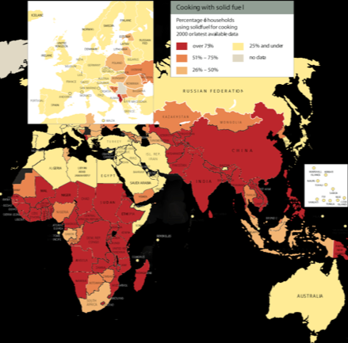
Cooking with biomass usage
Notes:
That’s about 1/3 of world population using biomass as a fuel source
<number>

Slide 9
Biomass production
In this bioregion the following have potential:
Bamboo
Camphor laurel
Lantana
Macadamia shells
Plantations, farms, roadside, nurseries, bush regen
Sustainably managed plantation timber waste
Agricultural waste

Slide 10
Biomass harvesting
Forage harvesting v individual stem harvesting
Relates to accessibility and cost of equipment
Differences between overdeveloped/underdeveloped worlds
Harvesting equipment
Sugar cane
Forestry
Agriculture

Slide 11
Biomass pelletisation
Biomass pelletization is the process of reducing the bulk volume of the material, by mechanical means for easy handling, transportation and storage of material.
In addition to the practical advantage of increased convenience, putting biomass in pellet form also decreases the moisture content, increases the density and maintains a high heating value.
Used in emergency humanitarian response eg. Haiti
Sold alongside stoves eg. World Stove, Stovetec
Locally, pellets available at Alstonville (produced at a mill in Woodburn)
Notes:
Concentration/diffusion principle
<number>

Slide 12
Local interviews 1
Main research questions were as follows:
What qualities do you look for in a stove?
What type of stove do you normally use for cooking?
What other methods of cooking have you tried?
What are your preferred methods of cooking?
Have you heard of biomass stoves?
Would you be interested in using one for a short trial of one month?
Any other comments or thoughts about this research?

Slide 13
Local interviews 2
Efficient and economical and ecological stoves were desired
Gas or electric cooking appliances were most popular
Baking or grilling were popular cooking types other than stove cooking
Baking or grilling were most popular cooking methods
Most candidates had not heard of biomass stoves
Most candidates were interested in participating in a biomass stove trial
Additional comments were varied including the desire to cook by adobe oven, willing to compromise on stove technology, desire to cook with dung and an opinion that the local community has a low usage of white goods and appliances suggesting that this area would be a good test bed for my stove

Slide 14
Community and Bioregional
Stoves can be manufactured on a community level which creates employment
Biochar produced by stoves can be used for soil amendment and water conservation in local food production systems
Appropriate microfinance structures have the potential to offer carbon credit exchange to local people creating biochar and using it in food production systems
Potential for further research in this region due to high cultural, economic and bio- diversity
Notes:
Microfinance especially relevant in underdeveloped world where majority of biomass is consumed and economic opportunities are low
<number>

Slide 15
Glocal (Global/Local)
International Biochar Initiative
Bioenergy Lists
Aprovecho Research Center
Bodger’s Hovel
Biomass Energy Foundation
Global Partnership Plant Conservation
Biochar.org
EPRIDA
Notes:
<number>

Slide 16
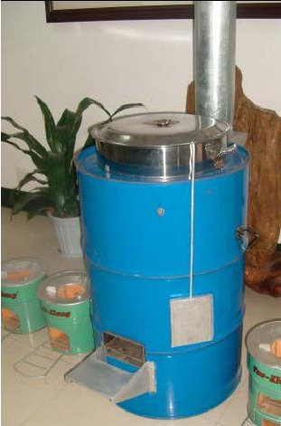
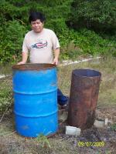
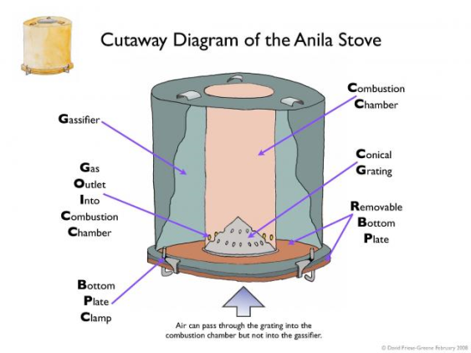
Stove overview
3 main types
Top lit updraft
(TLUD)
Carbon sequestration
Anila

Slide 17
Stove design and building - principles
Affordable
['Help make people self-reliant', 'Bring food production back to the cities', PDM]
Clean-burning eg.smokeless, no VOCs etc
['Produce no waste', PPP]
Durable
['Apply self-regulation and accept feedback', PPP]
Safe
[ 'People care', 'Help make people self-reliant', 'Bring food production back to the cities', PDM]
Sustainable
‘carbon negative’
(biochar productive and 'clean-burning') ['Catch and store energy', 'Obtain a yield', 'Produce no waste', PPP]

Slide 18
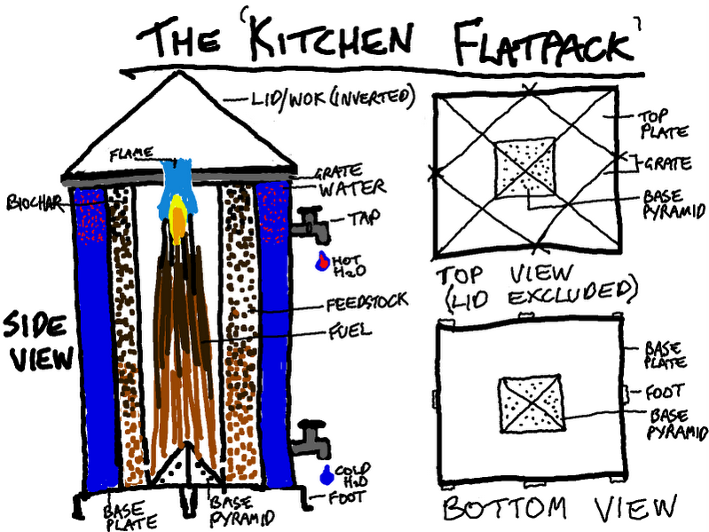
Stove design and building - Prototypes

Slide 19
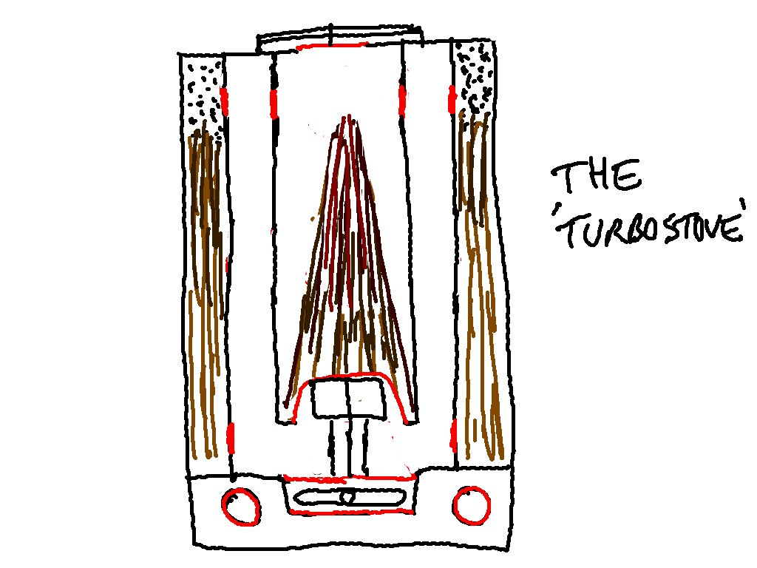
Stove design and building- Final
Permastove

Slide 20
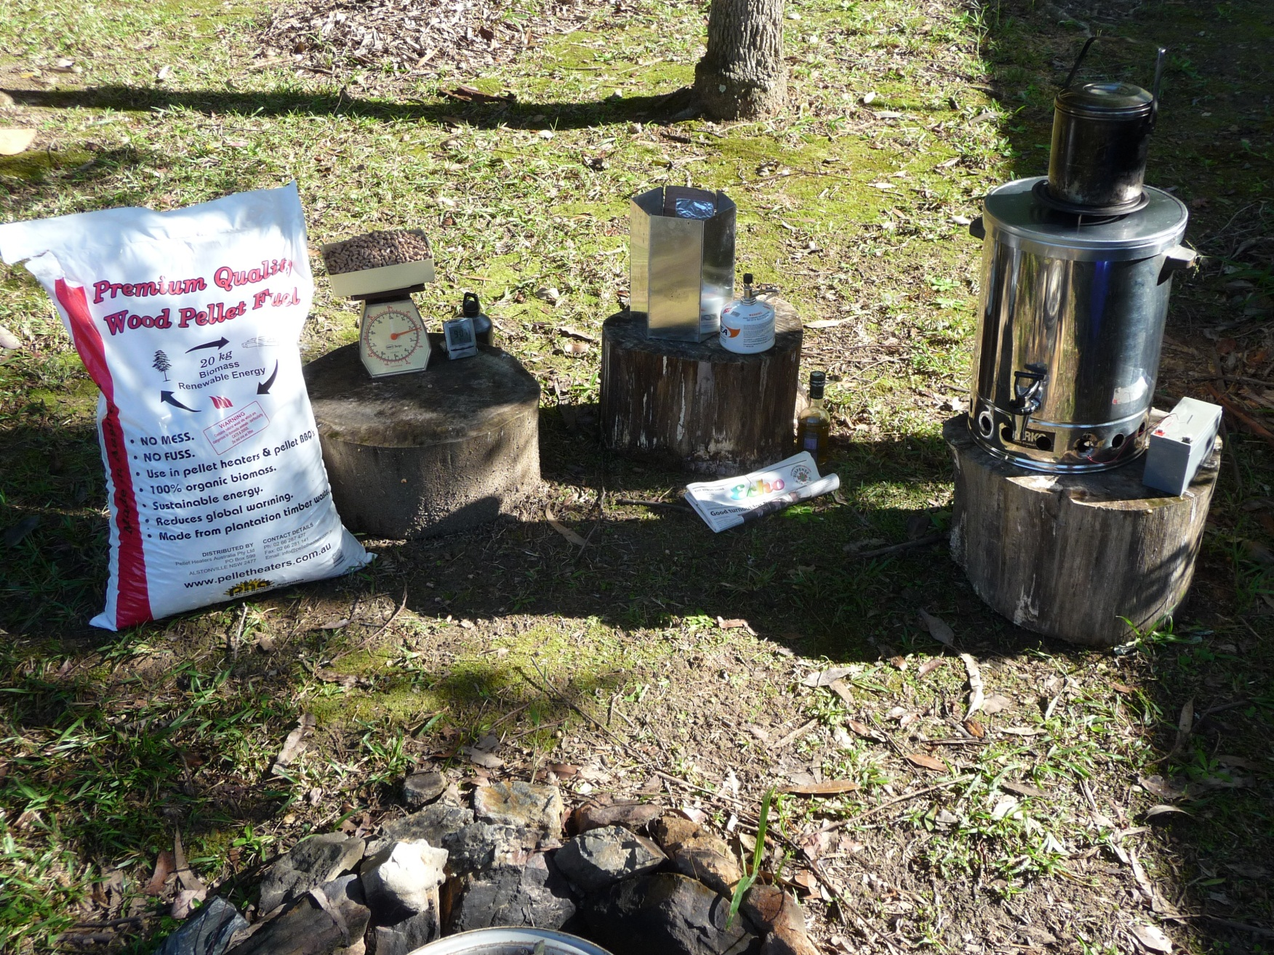
Permastove – the lab

Slide 21
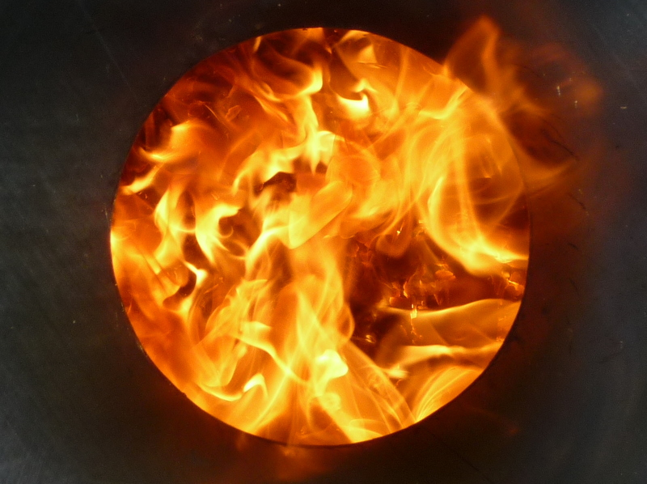
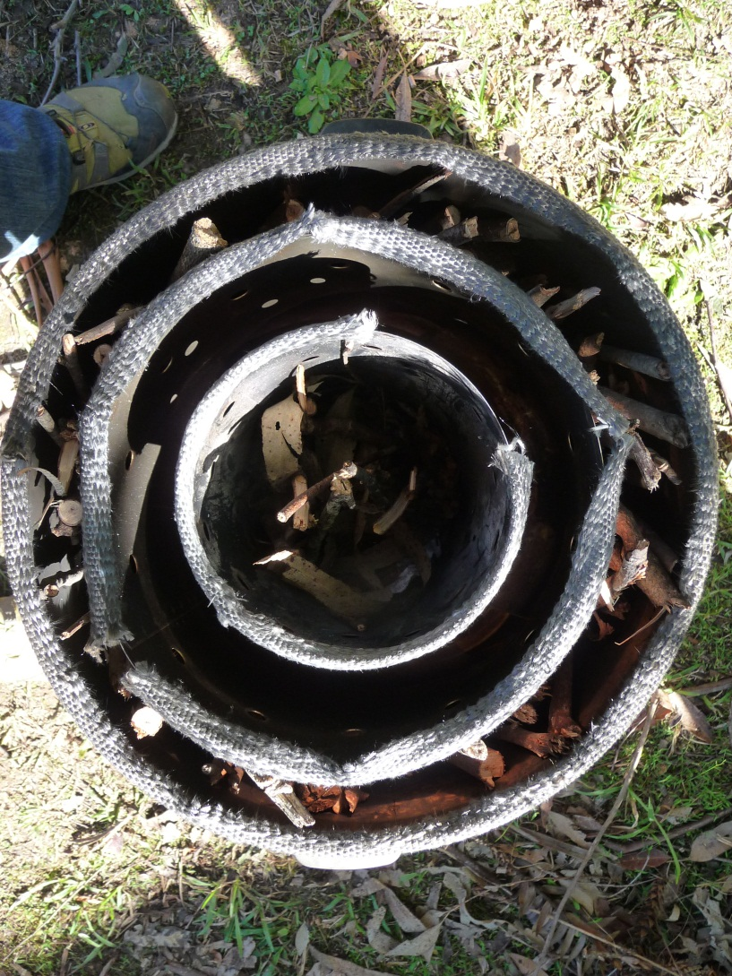
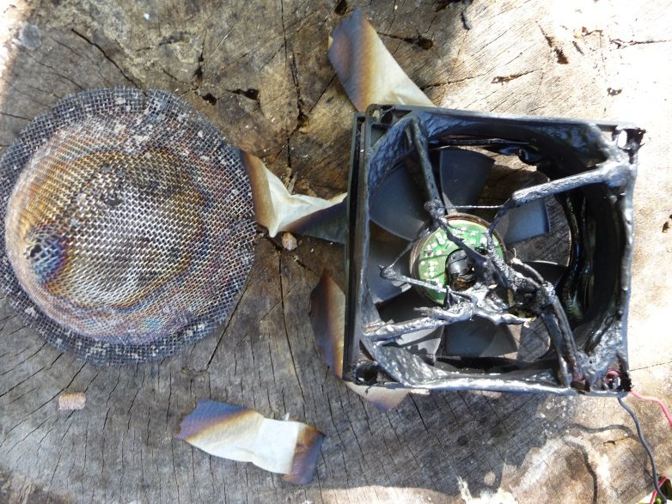
Permastove – ready to burn

Slide 22
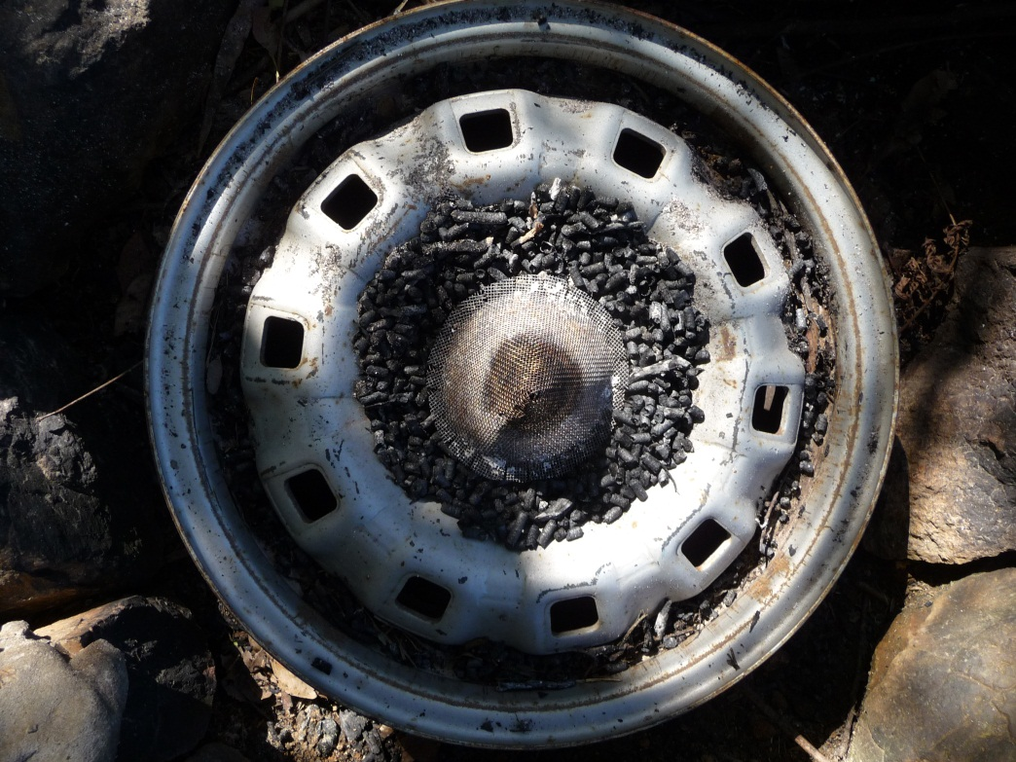
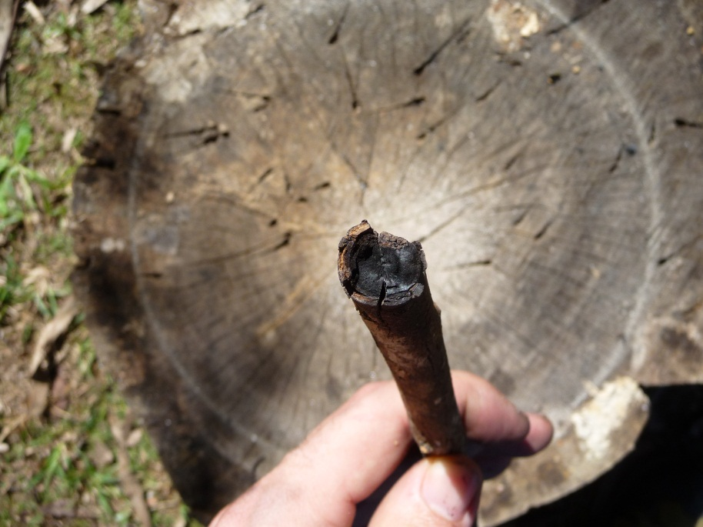
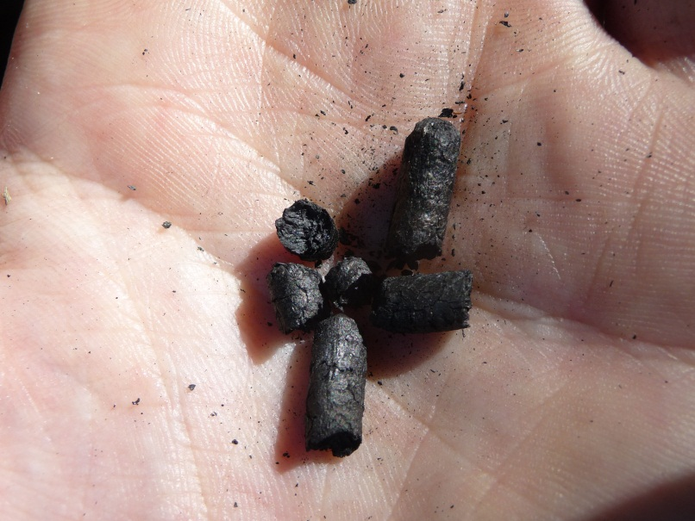
Permastove – biochar products

Slide 23
What’s the next step?
Go to stove camp
Aprovecho Research Centre, U.S.A.
Modify and test the design
Obtain funding for further research
Conduct research trial at community and bioregional scales
Contact relevant international development organisations and entities for participation in a stove program

Slide 24
What’s the next step?
Go to stove camp
Aprovecho Research Centre, U.S.A.
Modify and test the design
Obtain funding for further research
Conduct research trial at community and bioregional scales
Contact relevant international development organisations and entities for participation in a stove program

Slide 25
Conclusions
Research is stimulating and rewarding
Field testing reveals design strengths and weaknesses
Huge potential for more research in this area at local, bioregional and global scale
Stove comparisons
Fuel comparisons
Feedstock comparisons
Biochar system integration

